Slide 1
Teachers – Don’t show your students this slide.
With the idea of beginning with the end in mind, the goal with this activity is for students to get to the point where they will create a system of government that will organize their people.
The curriculum in my area includes this content: social, political, legal, governmental, and economic systems and structures, including at least one indigenous to the Americas.
If you have a similar curricular expectation in your area, feel free to download this activity and modify it to work for you.
I hope it helps.

Slide 2
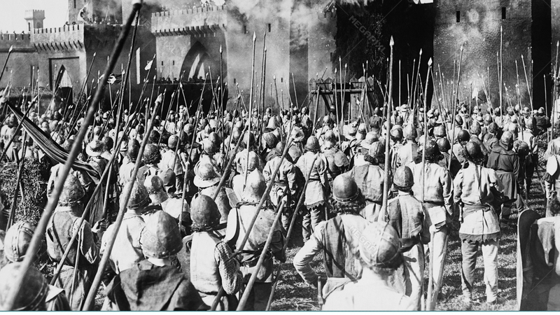
Unrest and Upheaval

Slide 3
Make a group of 3 or 4 people.
You’re an ancient group of people who have finally settled into a location after hunting and gathering for most of your existence.
In your group, imagine you have spent generations creating a safe place for your people to live. You have agriculture and grow a lot of food. You have building and construction skills and have used them to create safe homes.
After years of living in small settlements and villages, you begin to group together and form cities. Years pass, but you’re still figuring this thing out – after all, you’ve never had cities before.
Then, a challenge strikes.

Slide 4
Your cities are experiencing significant upheaval.

Slide 5
The development of your cities has led to a division of labour among your people. Some people are able to produce enough so that others do not have to. Unfortunately, this also means that some people have more food than others. Added to this, there have been several poor harvests. Several neighbourhoods have seen protests and fights break out over food. There has been looting. Some people are starving.

Slide 6
Then...

Slide 7
Disaster…

Slide 8
City populations have been struck by cholera.
People are scared. This mysterious disease is going through some neighbourhoods and sparing others. There is whispering of demons and dark worship. There have been fights. This is adding to the city's chaos.
20% of your population dies.
Many of your crops will go unharvested as no one can safely harvest the crops. You are unable to apply for new resources.

Slide 9
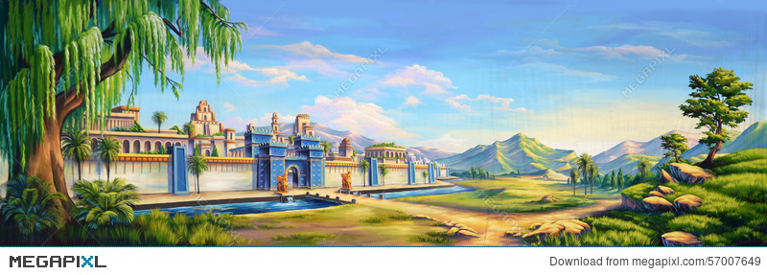
But….
If by the due date, you can find a way to prevent this from happening, your cities and people are safe.

Slide 10
Create a group presentation that explains your thinking in this round.
You must provide your sources.

Slide 11
Your cities are in chaos. There is no control. There is no organization. What do you do?

